Slide 1
Project Presentation of Industry Oriented Hands on Experience (22CS422)
On
Plotora
Samarpan Malhotra
2211981340
Supervised By
Dr. Swati Goel
Department of Computer Science and Engineering,
Chitkara University, Punjab

Slide 2
Introduction
Plotora is a web-based platform designed to improve how users interact with movies. In traditional platforms, users only watch content, but Plotora allows them to actively participate by creating alternate endings. This transforms users from passive viewers into active contributors.
In the current system, users have creative ideas but no proper platform to share them. Most discussions happen on social media, which are unstructured and lack recognition. There is no organized system for collaboration or creative contribution.
Because of this, a lot of user creativity is lost. Plotora solves this problem by providing a structured and engaging platform.
2

Slide 3
Objective
The main objective of Plotora is to create a platform where users can participate in storytelling in a structured way. It focuses on increasing engagement, encouraging creativity, and ensuring fair participation.
To achieve this, Plotora introduces genre-based clubs such as Action and Horror, where users can interact with like-minded people. Inside these clubs, users can browse movies based on trending, most watched, and recommended categories.
After selecting a movie, users can write their own alternate endings. This structured approach ensures that all contributions are meaningful and organized.
3

Slide 4
System Flow and Features
The system follows a simple and clear flow. First, the user logs in and joins a club. Then they browse movies based on different categories. After selecting a movie, they write an alternate ending, which is then reflected in the leaderboard and stored in the archive.
Plotora includes important features such as secure login using JWT, genre-based clubs, movie browsing system, and a structured submission module. It also includes a leaderboard to rank users and an archive to store the best stories.
These features ensure that the system remains organized, fair, and engaging for all users.
4

Slide 5
Technology Used
Plotora is developed using the MERN stack, which includes MongoDB, Express.js, React.js, and Node.js. This allows the entire application to be built using JavaScript.
MongoDB is used to store data like users, clubs, and stories. Node.js and Express.js handle backend operations such as API requests and server logic.
React.js is used to build the user interface and provides a smooth experience without page reloads. JWT is used for authentication to keep the system secure.
5

Slide 6
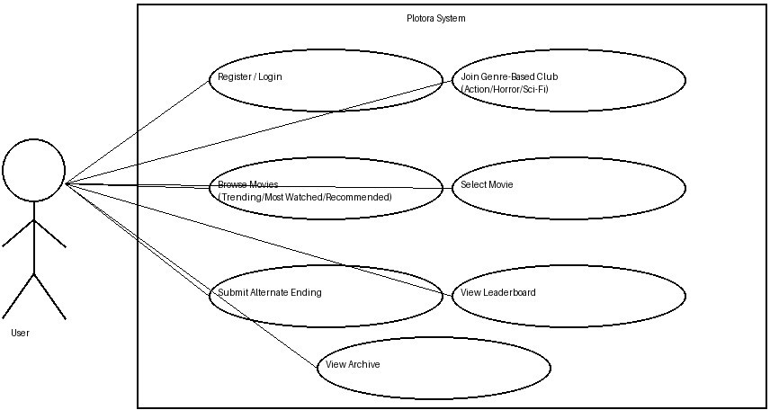
UML Diagram
6

Slide 7
Advantages and Novelty
Plotora offers several advantages such as increased user engagement, encouragement of creativity, and a structured system for participation. It ensures fairness and allows users to interact through clubs.
The unique aspect of Plotora is that it combines movie browsing with storytelling. Unlike traditional platforms where users only consume content, Plotora allows them to create content in a structured way.
Features like genre-based clubs, controlled submissions, leaderboard system, and archive make it different and more interactive.
7

Slide 8
Conclusion and Future Scope
Plotora successfully transforms the movie-watching experience into an interactive and creative process. It allows users to explore movies, create alternate endings, and gain recognition for their work.
The platform provides a structured and fair environment, making it more engaging and meaningful. It bridges the gap between content consumption and content creation.
In the future, the project can be improved by adding AI-based suggestions, developing a mobile application, and integrating external APIs for better movie data.
8

Slide 9
Thank You
9

